Slide 1
Geopandas Geoprocessing Techniques
By Antoaneta Chakarova
For Geog592
10/12/2026

Slide 2
This project asks where flooding and storm hazards may affect transportation and emergency access in Charlotte-Mecklenburg

Slide 3
Data Sources!
Source for Mecklenburg Boundary in all slides:
Name: Sphere of Influence
Source: City of Charlotte / Mecklenburg County GIS
https://arcg.is/0r9rnS2
Notes:
A lot of them were in 4326 projection and not 2264

Slide 4
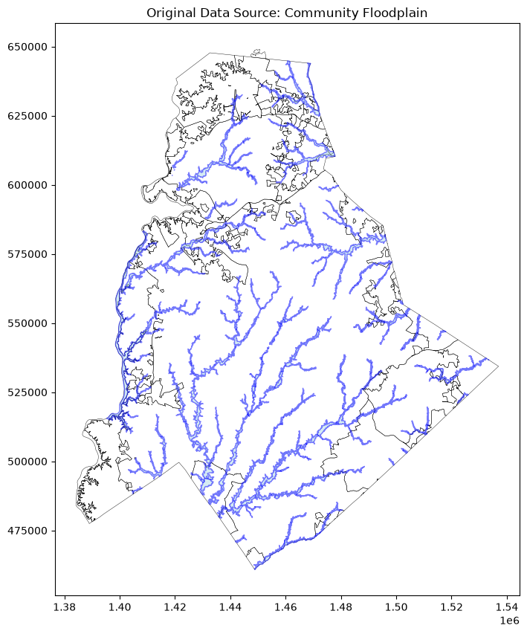
Community Floodplain
Community floodplain polygons used to identify flood exposed streets
Source: Charlotte-Mecklenburg Storm Water Services
https://www.charlottenc.gov/Services/Stormwater/Data-Apps

Slide 5
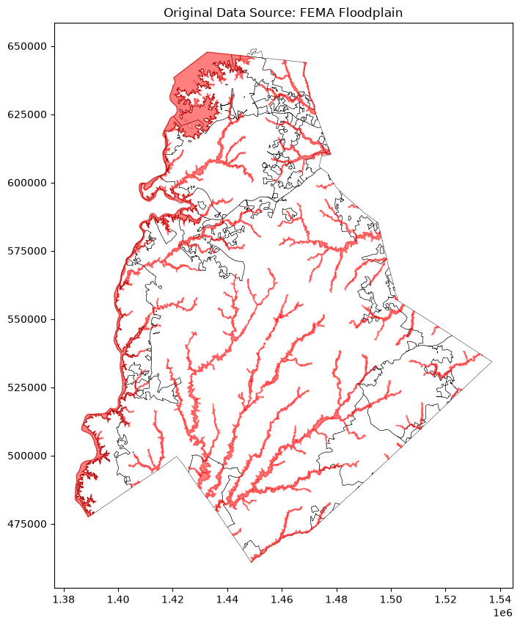
FEMA Floodplain
Source: Charlotte-Mecklenburg Storm Water Services / FEMA
https://www.charlottenc.gov/Services/Stormwater/Data-Apps

Slide 6
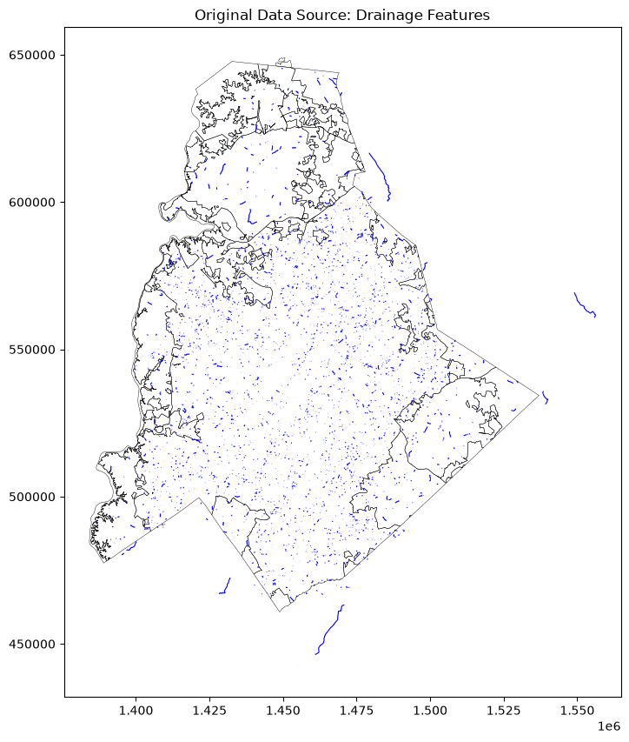
Drainage
Streams, creeks, and drainage channels used to create the 500-foot drainage buffer.
Source: City of Charlotte GIS
https://gis.charlottenc.gov/arcgis/rest/services/STM/StormDrainage/MapServer

Slide 7
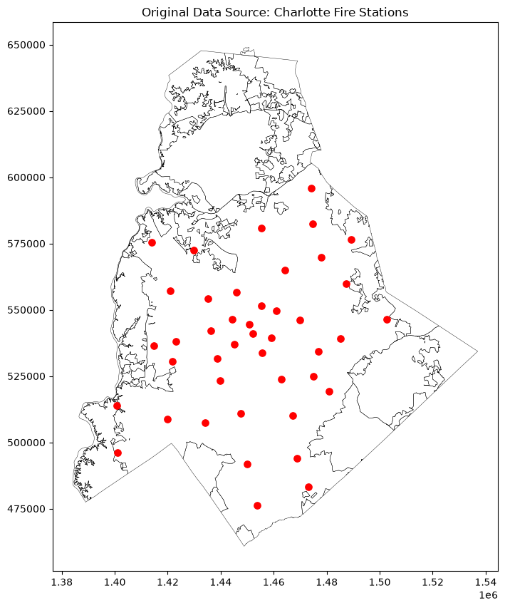
Fire Stations
Current Charlotte Fire Department station locations used in the drainage and emergency-access analyses.
Source: City of Charlotte GIS
https://arcg.is/1TT1a3

Slide 8
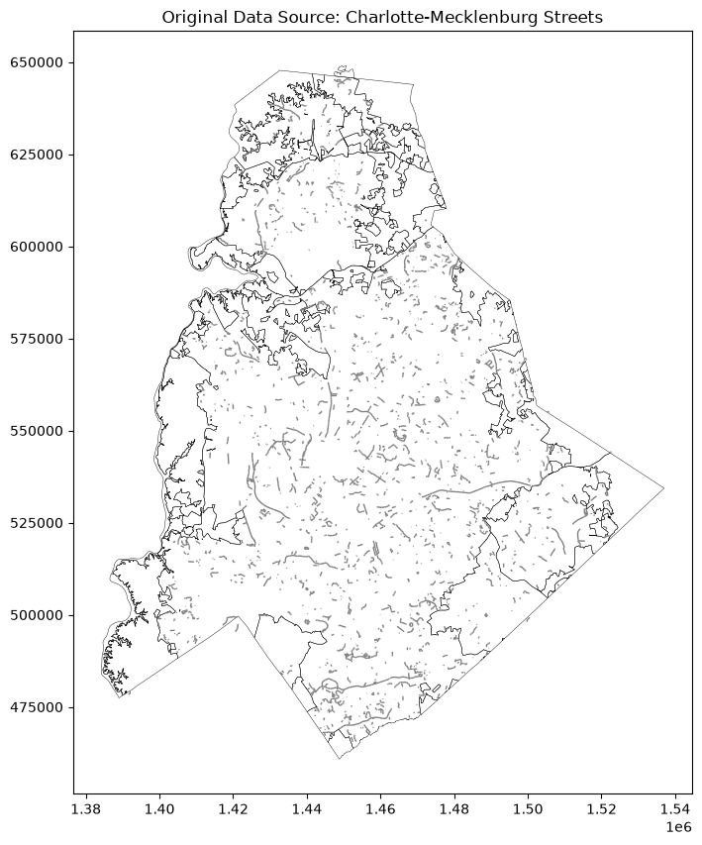
Streets
Charlotte-Mecklenburg streets used to identify roads exposed to flooding.
Source: City of Charlotte / Mecklenburg County GIS
https://gis.charlottenc.gov/arcgis/rest/services/CountyData/Streets/MapServer

Slide 9
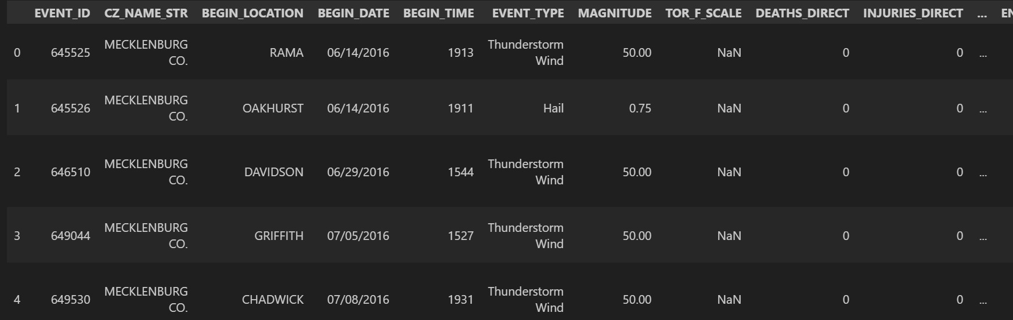
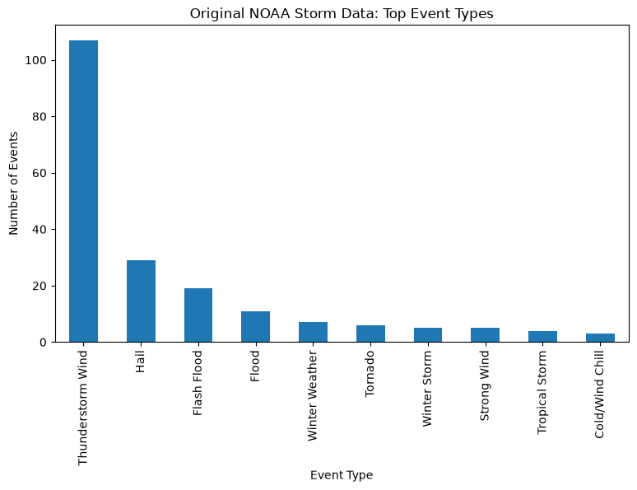
Storm Events
Non-spatial table of NOAA storm events used for the attribute join.
Source: NOAA National Centers for Environmental Information, Storm Events Database
https://www.ncei.noaa.gov/access/storm-events-database/

Slide 10
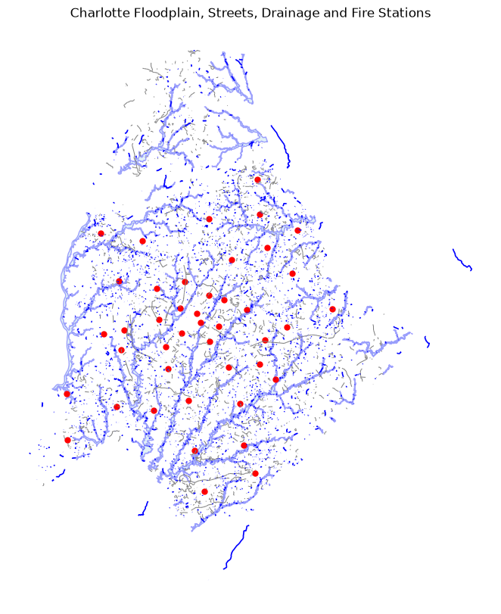
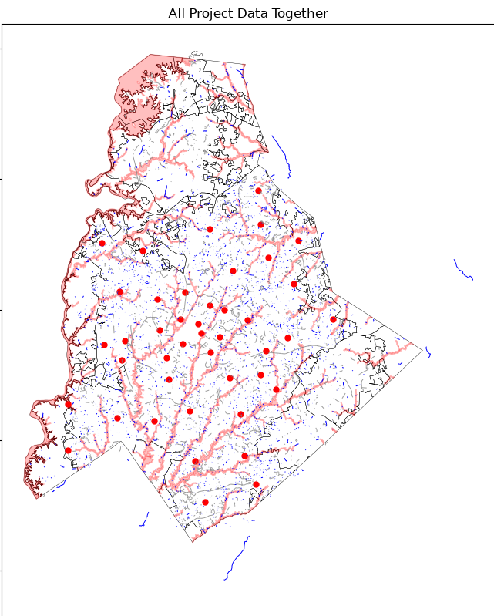

Slide 11
Questions Asked
1. Which street segments intersect the community floodplain?
2. Which fire stations are close to drainage features?
3. Which flood-exposed streets are near Fire Station 1?
4. What storm-event history from the NOAA table can be joined to the FEMA floodplain layer?

Slide 12
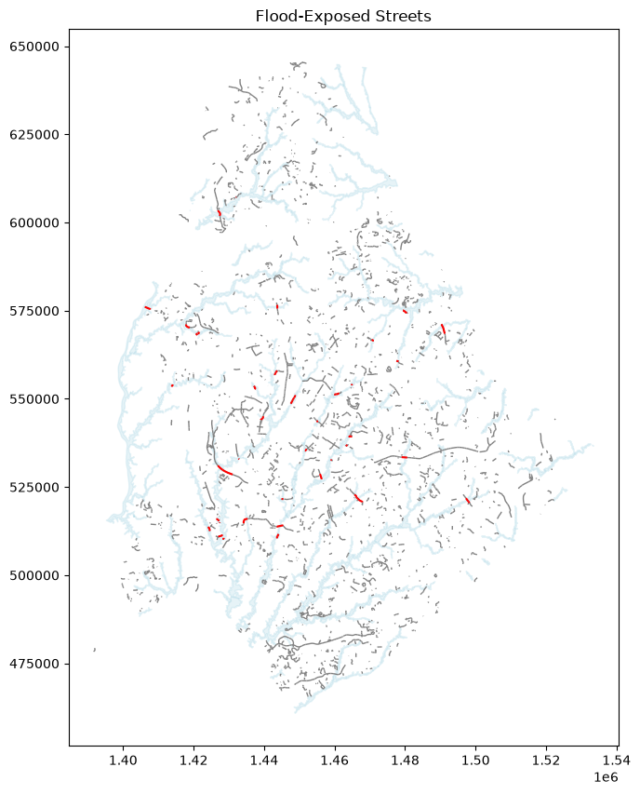
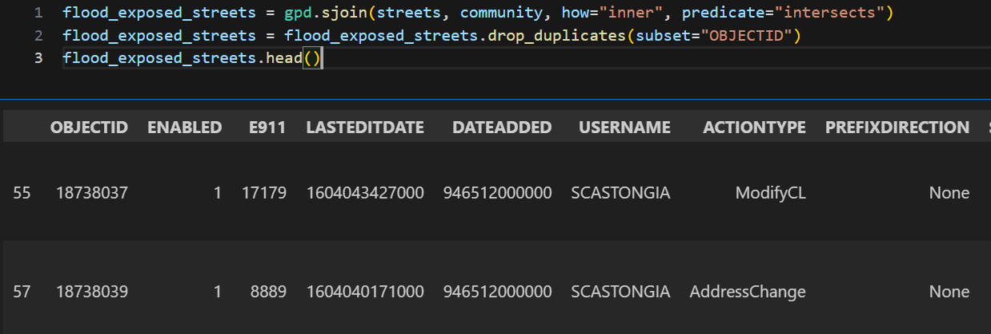
Layer #1
Question: Which street segments intersect the community floodplain?
What it does: Keep streets that overlap the floodplain, showing transportation segments that may be exposed to flooding.
Notes:
used an inner spatial join because I only wanted streets that matched the floodplain, and I used intersects because even partial overlap means a street may be flood exposed.

Slide 13
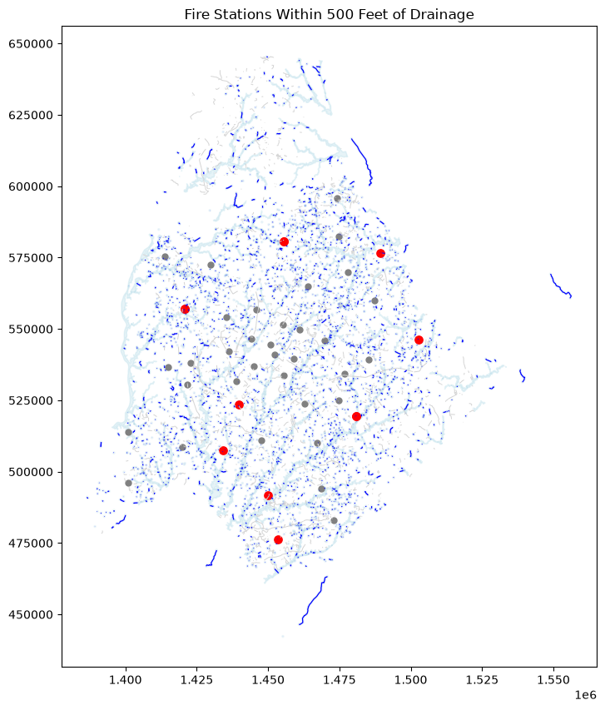
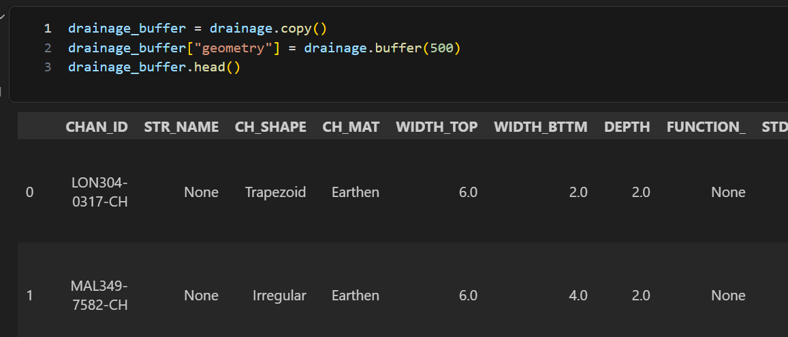
Layer #2
Which fire stations are within 500 feet of a drainage feature?
What it does: A 500-foot buffer around drainage shows the nearby area, and the red stations are the stations located inside that area. After, do sjoin (inner, within) between the stations and buffers.
Notes:
inner spatial join to keep only matching fire stations, and within because I wanted stations whose point location fell inside the buffer

Slide 14
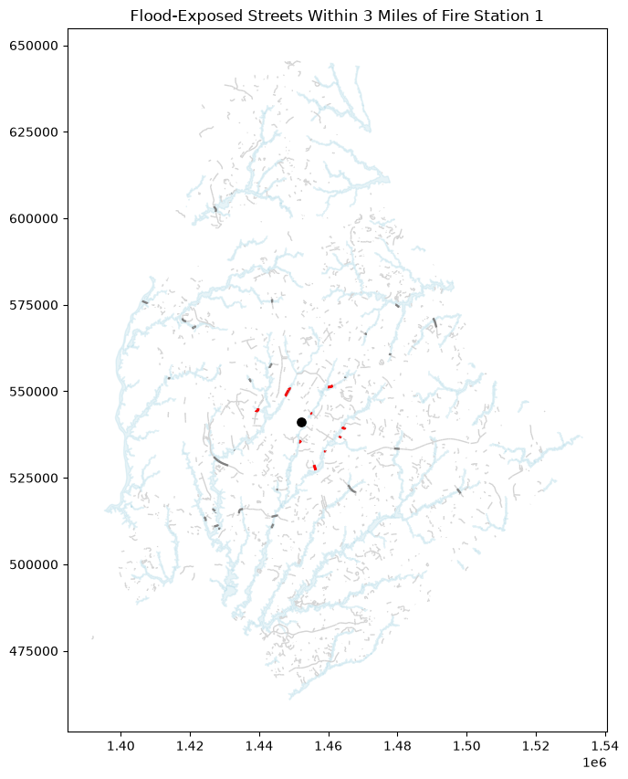
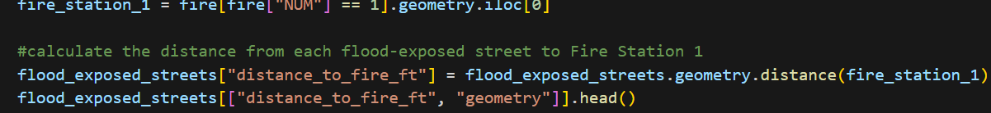
Layer #3
Question: Which flood-exposed streets are within 3 miles of Fire Station 1?
What it does: distance is measured from Fire Station 1 to the flood-exposed streets to identify nearby road segments that may matter for emergency access.
flood_exposed_streets["distance_to_fire_ft"].sort_values().head(10)
flood_streets_near_fire = flood_exposed_streets[flood_exposed_streets["distance_to_fire_ft"] <= 15840].copy()

Slide 15
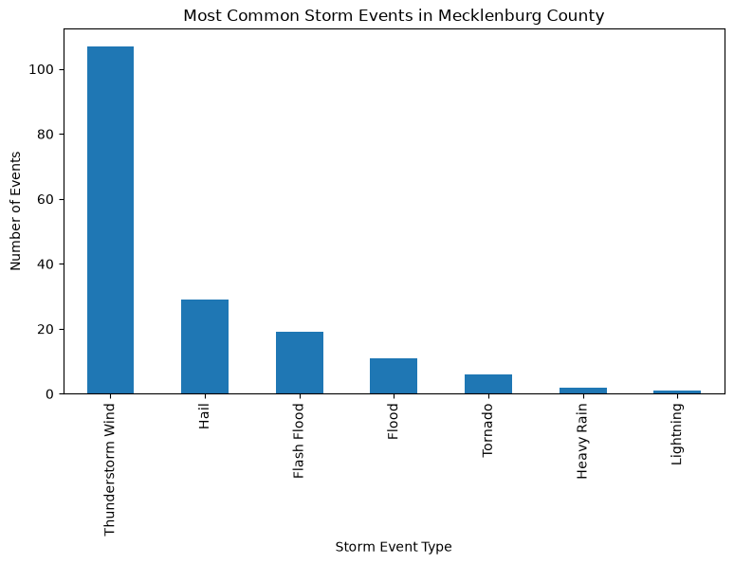
Layer #4
Question: What recent NOAA storm history is associated with the Mecklenburg County FEMA floodplain area?
What it does: Mecklenburg storm table is joined to the FEMA floodplain polygons, making a new spatial layer with floodplain geometry + storm attributes.
#keep the Mecklenburg County records from the downloaded NOAA table
mecklenburg_storms = storm_data[(storm_data["STATE"] == "NORTH CAROLINA") & (storm_data["CZ_NAME_STR"] == "MECKLENBURG CO.")].copy()
fema_storms = fema.copy()
fema_storms["COUNTY"] = "MECKLENBURG"
#attribute join where FEMA has the geometry and storm_summary has the table values
fema_storms = fema_storms.merge(storm_summary, on="COUNTY", how="left")

Slide 16
Thank you!

